Slide 1



STATEWIDE WORKPLACE
VIOLENCE COMMITTEE MEETING
New Jersey Healthcare Coalitions
  Tuesday, January 06th, 2026

Slide 2


AGENDA
Welcome + Housekeeping Items
Jasmine Glover (New Jersey Healthcare Coalitions)
Therapeutic Violence Mitigation and Team Safety
Puneet K.C. Sahota, MD, PhD (Cooper University Healthcare)
  Q & A - Statewide Workplace Violence (WPV) Committee
Closing Remarks
Jasmine Glover (New Jersey Healthcare Coalitions)

Slide 3

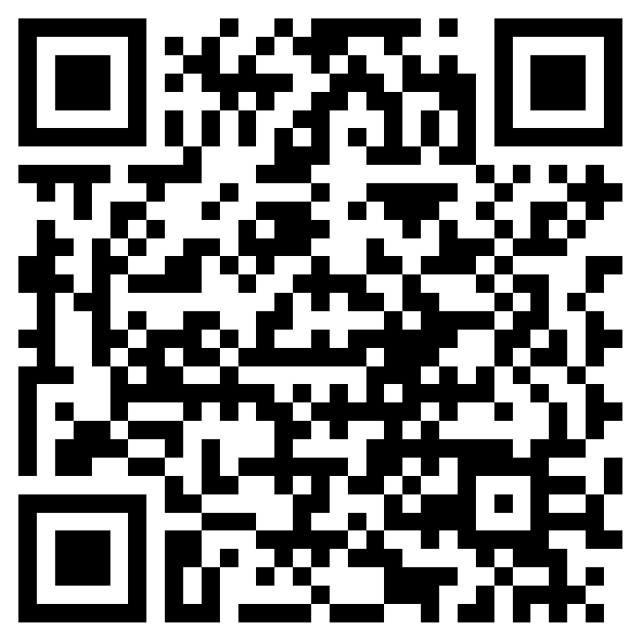
Have ideas or speaker suggestions for the Workplace Violence Committee?
Workplace Violence Committee
Membership Request
Scan this QR code to anonymously share your thoughts anytime. Your input helps us make our meetings more relevant and effective.
Thank you for your participation!

Slide 4
Therapeutic Violence Mitigation and Team Safety
Presented by Puneet K.C. Sahota, MD, PhD (Cooper University Healthcare)

Slide 5

Q & A
Notes:
Questions prepared for speaker:

Slide 6
FIFA World Cup 2026
Workplace Violence Considerations
Areas of concern?
Operational or preparedness challenges?

Slide 7

Save the Date!
The next Statewide WPV Committee Meeting will tentatively be held on
April 2026
Tuesday April 7th, 2026 10:30AM - 12PM
7
Spotlight Speakers: TBD
Suggestion
form

Slide 8
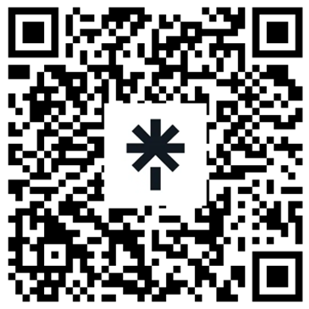
Updates/Closing Remarks
Feel free to scan our Linktree!
If you have any questions, comments, concerns, or topics you would like to see discussed, please don’t hesitate to reach out to us at rhcc@njha.com or 1 (800) 457-2262.
Additionally, please visit our website at: https://www.njhcc.org/workplace-violence/
for information as it relates to all aspects of workplace violence prevention in healthcare across the state of New Jersey.
THANK YOU FOR ATTENDING!!

