Slide 1
Therapeutic Violence Mitigation
Puneet Sahota, MD, PhD
Medical Director, TVM and Team Safety
Corey Doremus, PhD
Behavior Mitigation Psychologist
Cynthia Glickman, MD
Medical Director, Inpatient Personalized Care Plans

Slide 2
Therapeutic Violence Mitigation Aims
Develop and implement strategies for managing difficult patient situations
"Just Do It" pilot group of 4 patients: >90% reduction in violent events
Key components:
Preventative anticipatory measures
Acute management strategies
Responsive mitigation of care-interfering behaviors
Consistency in physician/provider approach
Post-acute debriefs separately with the care team and the patient
Follow-up review and study of acute events
Notes:
Builds on work by violence prevention committee, security, environmental, nursing leadership teams. Our charge, beginning in Feb 2024, was to focus here on physician/provider clinical workflows to prevent violence and bring together existing violence prevention tools in that streamlined workflow.

Slide 3
Comments from Patients and Leaders
"More people know some of what I've been through, and are treating me like a person, like they actually care about me" - pilot group patient with greatest reduction in violent events
"We have gotten less feedback from staff about feeling stressed. Less calls to the CODS. Great improvement in teamwork with primary teams. A lot less in behavior issues for the patients. Care plans and interventions are working and decreasing patient violent tendencies." - senior nursing leader

Slide 4
Clinical Workflow
Direct Clinical Care
Notify them to review care plan, agreement
Periodic check-ins during admission with care team, provider, patient
Meet with patients at bedside to present and review
Proactive clinical support for early consults, interventions
Implement level 1 precautions for risk of harm to self or staff
TVM Workgroup checks in with care team and provider
Automated TigerConnect alert upon arrival
Provide support to develop, revise care plans, agreement
Notes:
Informatics role key
BCS nurses in this workflow

Slide 5
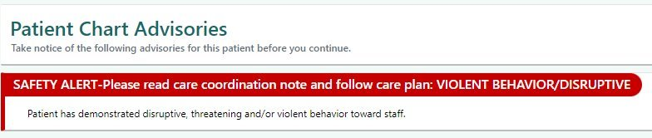
Electronic Medical Record: Patient Flag
Notes:
New phrasing of flag key

Slide 6
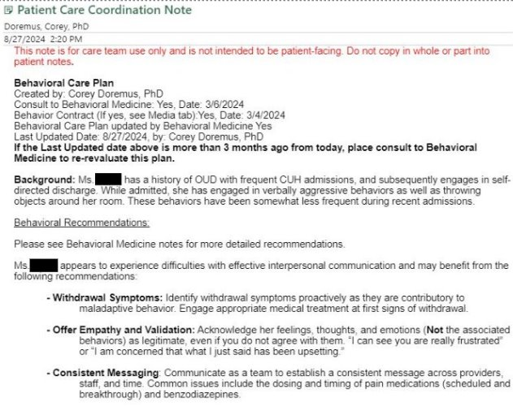
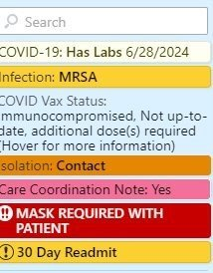
Behavioral Care Plans
Notes:
Input from care team to tailor each plan
Therapeutic communication scripting and limit setting

Slide 7
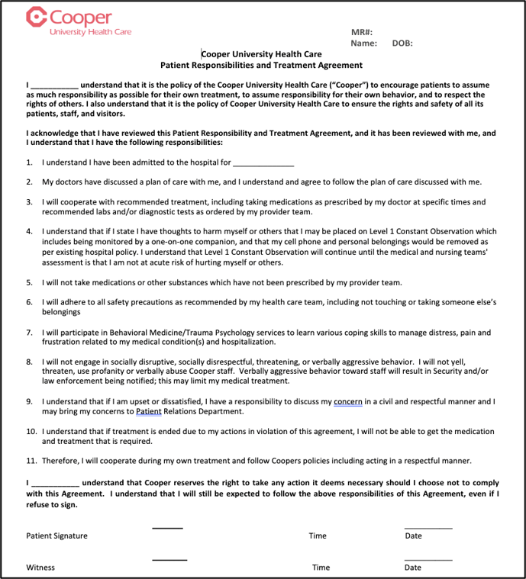
Patient Agreements
Notes:
Patient agreements commonly used in reaction to a sentinel violent event to try and prevent future ones. Sets out rights and responsibilities of the patient.

Slide 8
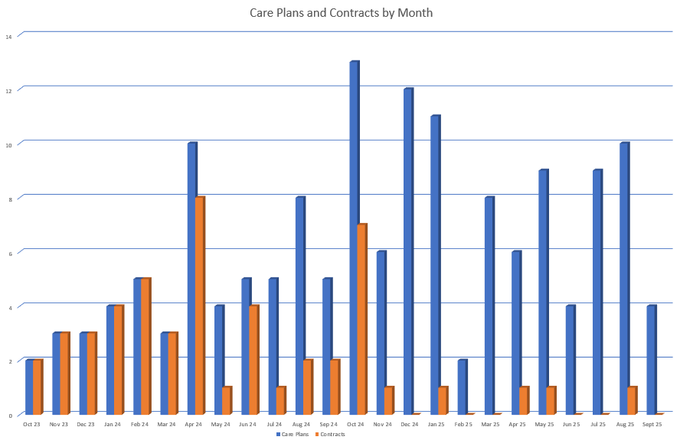
Care Plans and Patient Agreements
Notes:
Decrease in contracts / agreements shows preventive, and less reactive, mode. Intervening earlier means we don't get to a point where patients need contracts which include terms like administrative discharge.

Slide 9
Decrease In Violent Events
Notes:
Data on violent or disruptive behavior events (EARS and BRRTs) collected for the one year before and the one year after care plan written for sample of patients (care plan done May to August 2024, N=22)
Excluded those without subsequent admissions (N=10)
Of 12 patients included, there were 40 total events in the year before care plans and 11 events in the year after (73% reduction).
Pre-care plan events = 22 EARS reports and 18 BRRTs.
No BRRTs in the year after

Slide 10
2026 Activities
Ambulatory workflow refinement
Non-volitional violence prevention workflow for inpatients
Cooper Cape workflow development
Medication guidance in care plans
Inpatient: door signage (team members without Epic access)
In service/training support
De-escalation training module
Case-based education for Nurse Residency Program
Monitoring outcome measures:
Number of patients with violence flags, care plans, contracts
Number of behavioral rapid responses and EARS for violent events
Disseminating information (publish, present)

Slide 11
De-escalation Principles
Psychological safety is prioritized
Aggression has many forms
Both physical and verbal aggression must be addressed
This can be done in a therapeutic, supportive way for the patient/family
Project Beta
https://pmc.ncbi.nlm.nih.gov/articles/PMC3298202/pdf/wjem-13-01-17.pdf

Slide 12
Non-verbal Communication
Maintain at least 2 arms' lengths of distance between you and the patient
Keep hands visible and unclenched
Stand at an angle out of reach
Calm demeanor and facial expressions
Make sure words and actions are congruent

Slide 13
Verbal De-escalation
Only one person verbally interacts with the patient
Introduce yourself to provide orientation and reassurance
Keep it simple
Repetition is essential to successful de-escalation
Use free information to identify wants and feelings
"I really need to know what you expected when you came in"
"Even if I can't provide it, I'd like to know so we can work on it"
Use active listening/clarifying statements
"Tell me if I have this right..."

Slide 14
Negotiate Shared Understanding
Three ways to agree
Agree with the truth: "You're right, X is a serious concern"
Agree with the principle: "Everyone deserves to be treated with respect"
Agree with the odds: "Other people probably feel that way too"
If there is no way to honestly agree, agree to disagree
Offer a choice
Broach the subject of solutions possible within clinic's framework
Be optimistic and provide hope

Slide 15
Therapeutic Limits, Coping
Establish basic working conditions
Limit setting must be reasonable and done in a respectful way
Coach the patient in how to stay in control
If de-escalation unsuccessful, use security resources
Strongline Alerts for co-worker response & security/police response
Acknowledge shared humanity
Allow yourself to view aggression as suffering
Peer support

Slide 16
Key Takeaways
This meeting was called to action at 10:30AM
· Attendance (Excluding NJHCC Staff): 43
· Welcome
o Jasmine Glover, Emergency Management Coordinator, opened the meeting with a general introduction.
· Presentation: Puneet K.C. Sahota, MD, PhD Division Head, Consultation-Liaison & Emergency Psychiatry & Medical Director, Therapeutic Violence Mitigation & Team Safety at Cooper University
o Puneet Sahota, presented on Cooper University Healthcare’s Therapeutic Violence Mitigation and Team Safety Initiative
o Highlights and early data
o Therapeutic Violence Mitigation Aims
§ Develop and implement strategies for managing difficult patient situations
§ “Just Do It” pilot group of 4 patients >90% reduction in violent events
· From group of 10 most violent patients in the hospital
· 67 total violent reports prior to initiative
· 2 events after 6 months of workflow with selected 4 patients
§ Key Components:
· Consistency in physician/provider approach
· Preventative anticipatory measures
· Acute management strategies
· Responsive mitigation of care-interfering behaviors
· Post-acute debriefs separately with the care team and the patient
Workplace Violence Committee Meeting Date: 01.06.2026 Venue: Virtual (Microsoft Teams)
· Follow-up review and study of acute events
§ Clinical workflows utilize resources and tools
o Early pilot results and data
o Patients felt that through workflows feel more cared for
o Helping patients feel more heard and try to mitigate frustrations early on
o Clinical Workflow
§ Automated TigerConnect alert upon arrival
§ TVM workgroup check in with care team and provider
§ Direct clinical care
§ Periodic check-ins during admission with care team, provider and patient
o Flags in Patient Electronic Medical Record
o Behavioral Care Plans-under care coordination note if applicable
§ Every care plan includes scripting for when speaking to patient
o Patient Agreements
§ Used to give patient limits around appropriate behavior
§ Useful when patients have control over their behavioral
§ Difficult to enforce
§ Now including enforceable actions such as securing the room, observer at all times, phone securing
§ Before TVM: used reactively post violent event
§ Now seeing more therapeutic care plans and less patient contracts
o 2nd Analyzed Group: Decrease in violent events overall
§ 22 patients who received care plan between May-August 2024
§ After 1 year period analyzed in September
§ 1 year prior 40 events
§ 1 year after 11 events
o 2026 Activities
§ Ambulatory workflow refinement
§ Non-volitional violence prevention workflow for inpatients
§ Cooper Cape workflow development
§ Medical guidance in care plans
§ In-patient: door signage
§ In service/training support
· De-escalation training module
· Care-based education for Nurse Residency program
§ Monitoring Outcome measures
§ Disseminating Information
o Key Takeaways
§ Therapeutic Violence Mitigation improves patient experience and team member safety
§ Increases clinical team engagement and morale
§ Consistent implementation of care plans and patient agreements is critical
§ Physician, psychologist, nurse consultants available for support
§ Patient autonomy and workplace safety go together
· Questions:
o Eric Kane-director of security at Cooper Cape
§ Going into New Year: looking to bring more to Cooper Cape and establish a team to handle issues?
§ Puneet: Yes, that is the plan and trying to provide telehealth to Cooper Cape and additional resources
o How does the plan work when you use an interpreter for individuals who do not speak the same language
§ Use interpreter in every interaction is critical but still plan to follow care plan as close as possible
o The Des-escalation Training module is that in person or via on-line? If its in person how long is your class?
§ Done in person and online
§ In-person is 45 minutes
o Can you repeat the details about where the article was recently published?
§ Article was posted in

Slide 17

Thank You

